Slide 1

DAB- 400 Supply Chain Analytics
GROUP – 4
Group Members
Amith John Varkey
Mohammad Hashim
Delta Joseph
Bhavya Vinod

Slide 2

COTTON INDIA PRODUCTION

Slide 3
INTRODUCTION
Time series forecasting deals with sequence of data point in order of time. It involve analyzing time series data to get meaningful of insight.
So this method is used in order to predict the future values of the data.
Most of the time series analysis is a type of regression analysis since we are predicting or forecasting a number .

Slide 4
ABOUT THE DATASET
We are using cotton India production dataset from Kaggle.
It has five Features and 69 rows
Year - 1947 to 2017
Area
Production
Kg/Hectare
Irrigation
This is a yearly dataset.
But we are only using two columns. Such as year and production.

Slide 5
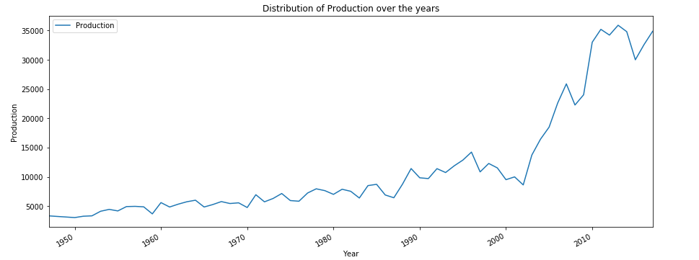
The graph depicts the yearly production of cotton from 1947 to 2017. We can observe a stable growth till 2000, later there was a steady increase and reached the peak by the end of the decade.

Slide 6
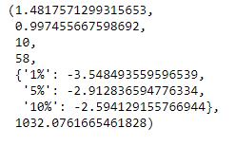
Dicky-Fuller Test

Slide 7



TOOLS USED

Slide 8
Models Implemented
Moving Average
Exponential Smoothing
Machine Learning Models
Time Series Models
LSTM

Slide 9

Observations

Slide 10
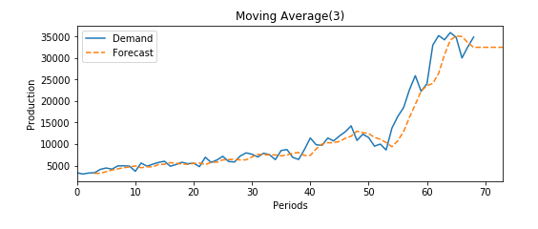
Moving Average method (MA) prediction Result
3 Year moving Average
MAE – 1624.08 and RMSE – 2583.21

Slide 11
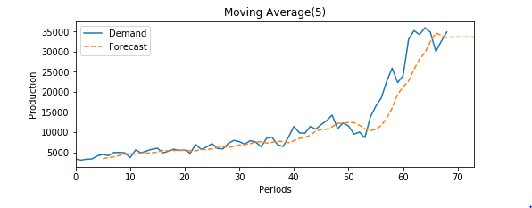
5 Year Moving Average
MAE score - 2073.3 ; RMSE score - 3249.59

Slide 12
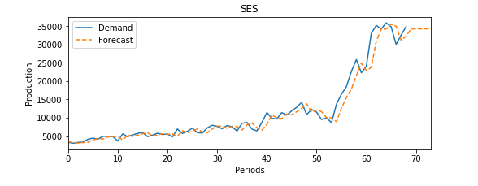
Single Exponential Smoothing method prediction Result
So from this figure, we get a clear picture of the plot with demand and forecasts, with α = 0.77 the MAE value is 1385.42 and RMSE value is 2102.46. In the X- axis we have periods and Y- axis we have production. The demand and forecasting have a gradual increase until 50 and exponentially growing till 60 and starts to become stabilized after that.

Slide 13
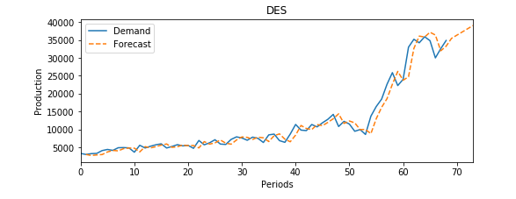
Double Exponential Smoothing method
We have periods in X-axis and production in Y-axis, demand and forecasting is gradually increasing until 50 and shows an exponential growth after that. We used α = 0.81 and β = 0.07, with that we got MAE value as 1388.81 and RMSE value as 2043.45.

Slide 14
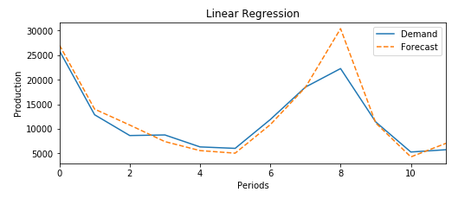
Machine learning models
Linear Regression
we have periods in X-axis and production in Y-axis. Demand and forecasting is showing a gradual decrease until period 5 and it showed a steep increase till 8. Here, we have MAE value 1605.78 and RMSE value 2592.37.

Slide 15
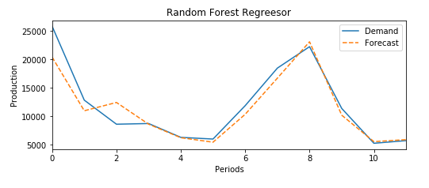
Random forest
We have periods in X-axis and production in Y-axis, here the fig is showing a steep decrease until 4 and then steep increase until 8. Here MAE value is 1472.78 and RMSE value is 2156.69.

Slide 16
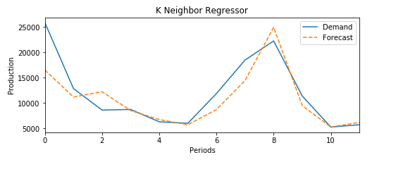
K – neighbour regressor
In the K Neighbour regressor, we got MAE value 2320.8 and RMSE value 3431.05

Slide 17
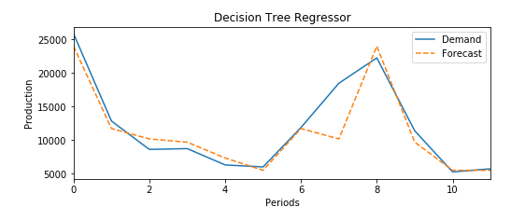
Decision tree regressor
In the Decision regressor, we got MAE value 1617.46 and RMSE value 2653.87.

Slide 18
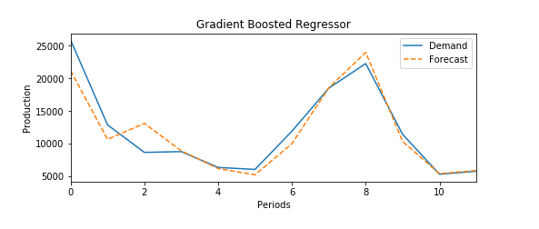
Gradient boosted
In Gradient boosted we used n_estimators as 500 and learning rate as 0.01 for building the model.
Here in the graph we have periods in X-axis and production in Y-axis, its showing a gradual decrease until 5 and a steep increase until 8.
Here, MAE is 1456.49 and RMSE is 2151.14. This model gave us the best results among the machine learning models.

Slide 19
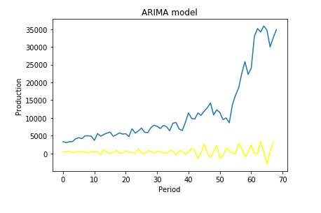
ARIMA
From this graph we can clearly see that the model was worse in predicting the values and that is the reason why we got worst values for MAE AND RMSE as MAE value 11149.0 and RMSE value 14625.0. ARIMA gave us the worst results among the machine learning models.

Slide 20
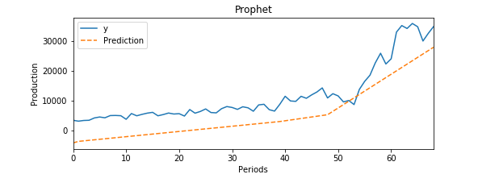
Prophet
In the Prophet model, we got MAE value as 5180.32 and RMSE value as 5982.91.
This model was almost working good in prediction but it was not having good values for MAE and RMSE as compared to other models.

Slide 21
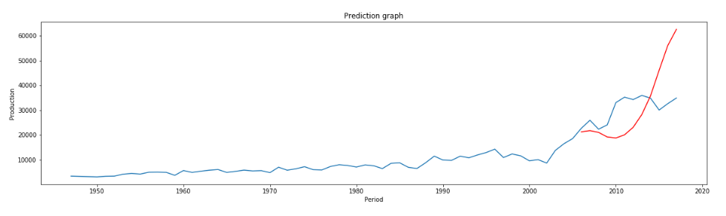
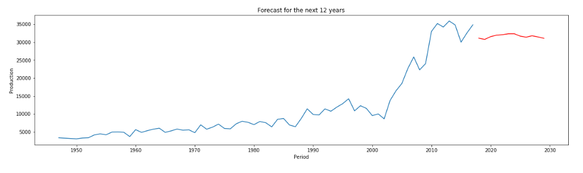
LSTM PART1- epochs =180, optimizer = adam
Here, the first graph shows the prediction of the LSTM model for the test data that we have created and how it is varied from the actual data whereas the second graph shows the forecast of LSTM model for the next 12 years.
For the LSTM model with epochs value as 180 and optimizer as adam , we got MAE value 10683.33 and RMSE value 13657.3.

Slide 22
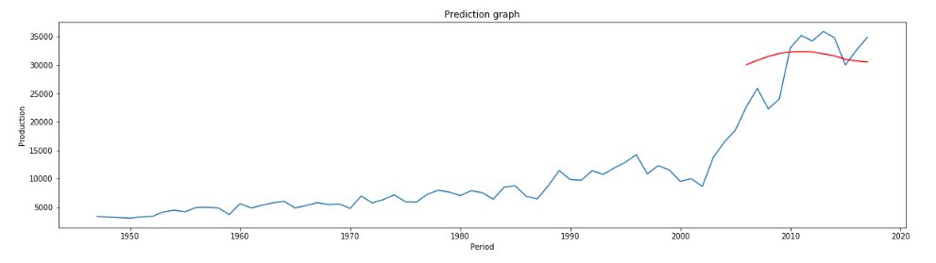
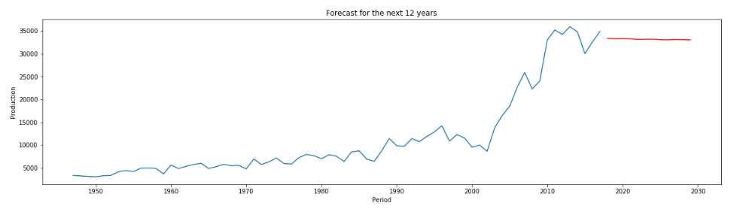
Part 2: epochs = 250 , optimizer = Adagrad
Here, the first graph shows the prediction of the LSTM model for the test data that we have created and how it is varied from the actual data whereas the second graph shows the forecast of LSTM model for the next 12 years. For the LSTM model with epochs -250, we got MAE value 4111.91 and RMSE value 4912.05.

Slide 23
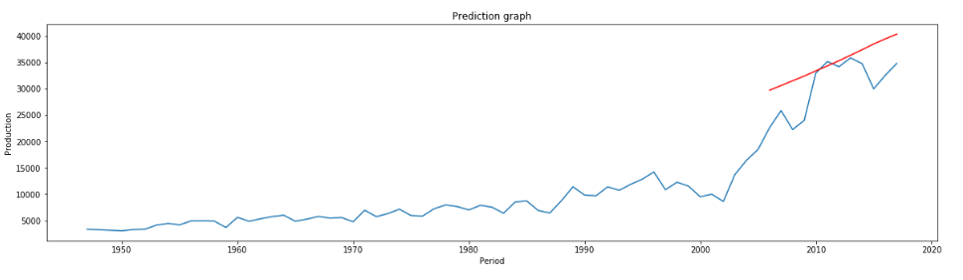
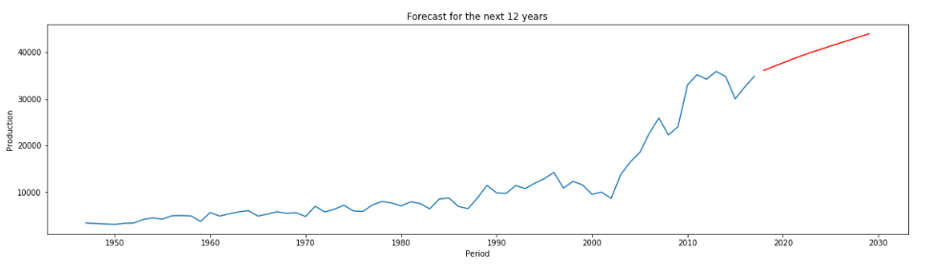
Part 3 : epochs = 300 , optimizer = sgd
Here, the first graph shows the prediction of the LSTM model for the test data that we have created and how it is varied from the actual data whereas the second graph shows the forecast of LSTM model for the next 12 years. For the LSTM model with epochs -300, we got MAE value 4680.12 and RMSE value 5713.92.

Slide 24


Challenges
The main challenge that we faced was that, the data was a yearly data so we was not able to resample it to monthly data or weekly data and also we had data only from 1947 to 2017, so the data was not stationary and we were able to prove it from Augmented Dicky Fuller test, since the ADF test statistics value was greater than the 5% critical value.

Slide 25
RESULT
Models Implemented | MAE | RMSE
3 years Moving Average | 1624.08 | 2583.21
5 years Moving Average | 2073.3 | 3249.59
Simple Exponential Smoothing | 1385.42 | 2102.46
Double Exponential Smoothing | 1388.81 | 2043.45
--------Machine Learning Models-------------
Linear Regression | 1605.78 | 2592.37
Random Forest Regressor | 1472.78 | 2156.69
Decision Tree Regressor | 1617.46 | 2653.87
K- Neighbor Regressor | 2320.8 | 3431.05
Gradient Boosting Regressor | 1456.49 | 2151.14
ARIMA | 11149.0 | 14625.0
Prophet model | 5180.32 | 5982.91
------------------LSTM ------------------------------
Part 1 : epochs = 180, optimizer = Adam | 10683.33 | 13657.3
Part 2 : epochs = 250, optimizer = Adagrad | 4111.91 | 4912.05
Part 3: epochs = 300, optimizer = sgd | 4680.12 | 5713.92

Slide 26
Conclusion
So, we got better result for Double exponential Smoothing Technique with alpha =0.88 and beta value as 0.07 which we have found out through excel, since it was having the least value for MAE and RMSE which were the two metrics we have used in order to evaluate the models.

Slide 27
Reference
Referred to all the projects and labs we have completed in class.
https://stclairconnect-my.sharepoint.com/:b:/g/personal/w0735036_myscc_ca/EYcsU7qV9CBJg2R2h_4ncD4BAtiR96fJv274SqXw36_4CQ?e=HcfsUc
Project Code: https://stclairconnect-my.sharepoint.com/:u:/g/personal/w0735036_myscc_ca/EeVqbkSwYoVGj6e2Ucbj-IwB8dm1bzhGYj1KgGUCUqpGKQ?e=6szSN1

